Slide 1
System for BPI data analysis
A presentation by Brijgopal Bharadwaj

Slide 2
Overview:
Project Aim
GUI – a synopsis
Error Handling
File structure
The algorithm for each process.
Key data attributes.
Data representations

Slide 3



Project Aim (so far…):
Data accumulation
Data assimilation
Data wrangling
Data representation
Clustering analysis
Summarizing observations
Visualizing results
Documentation

Slide 4
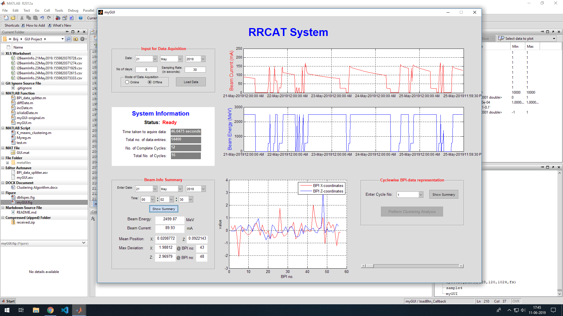
GUI-a synopsis

Slide 5
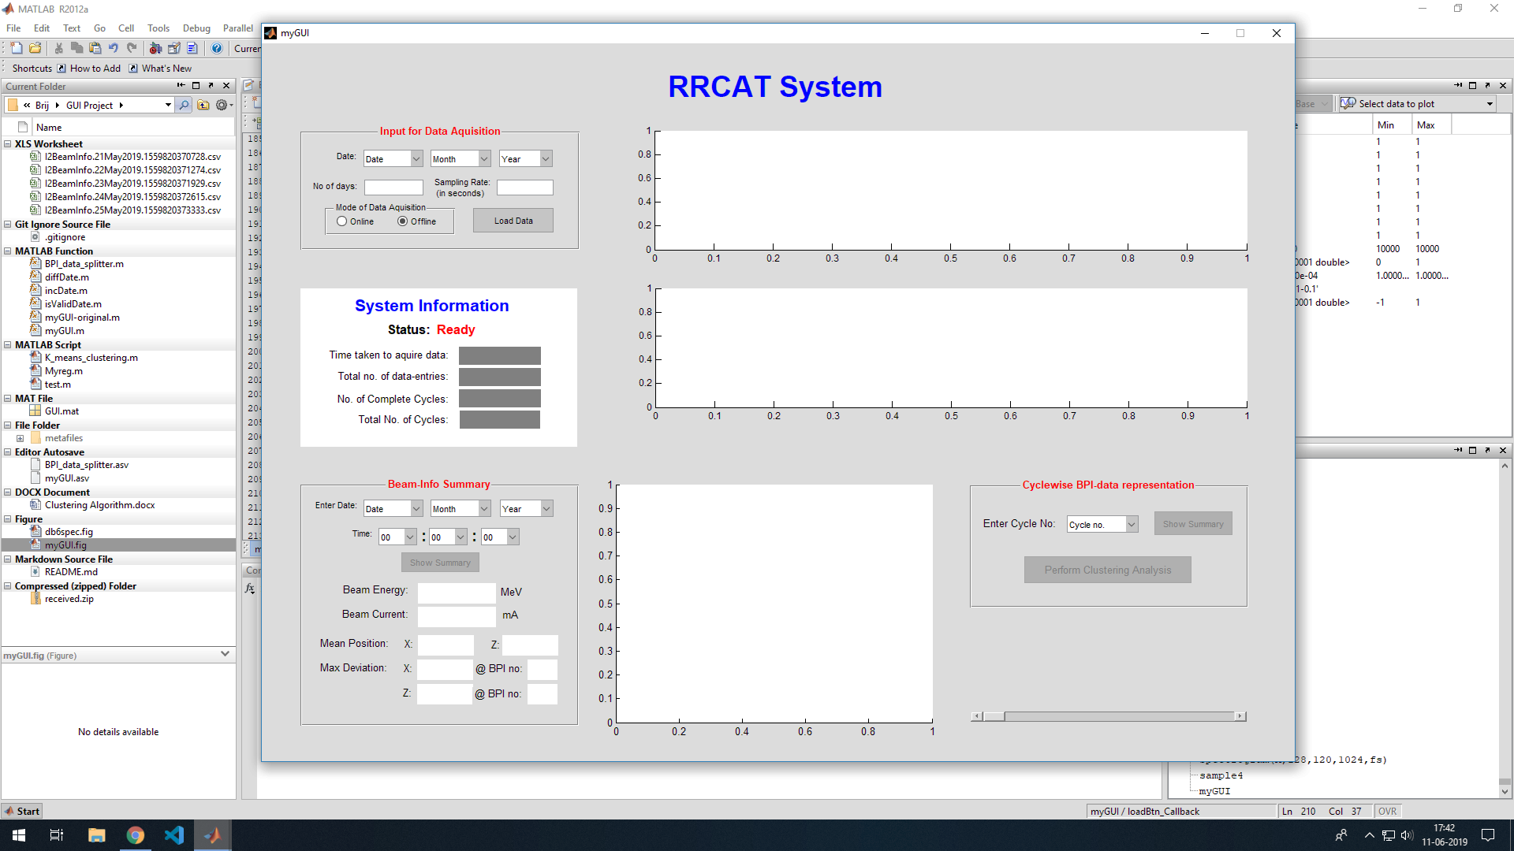

Slide 6
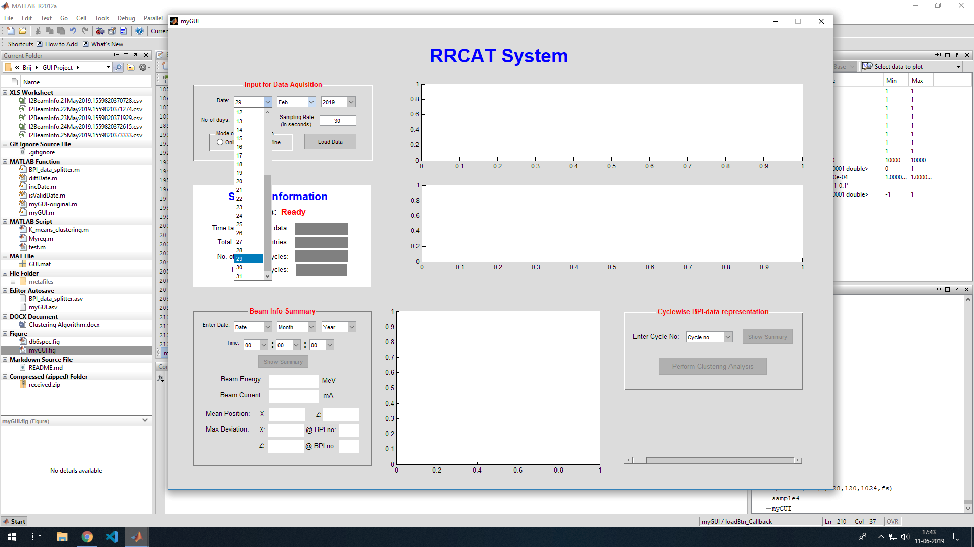

Slide 7
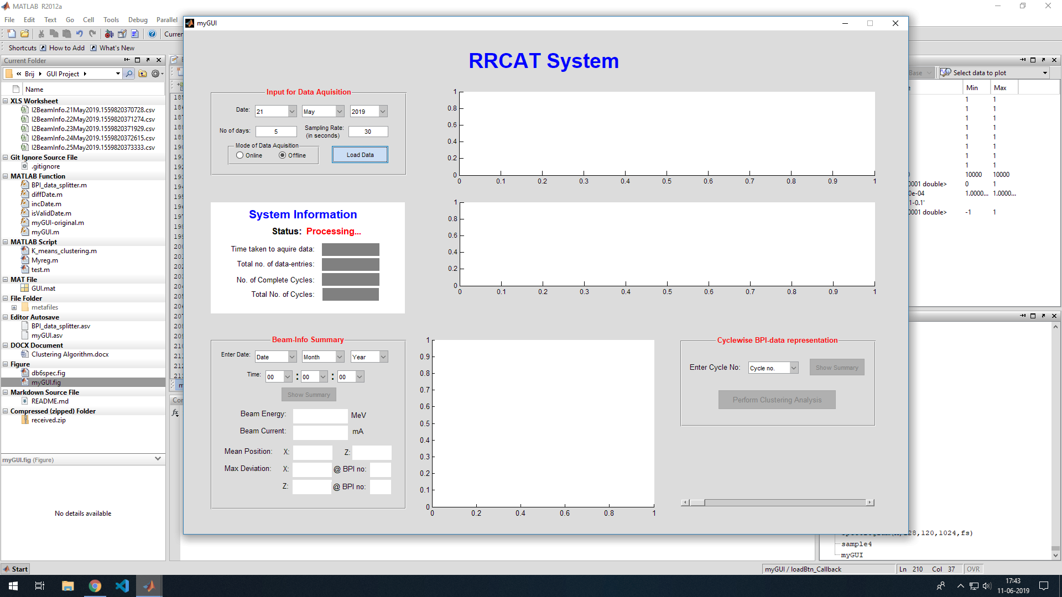

Slide 8
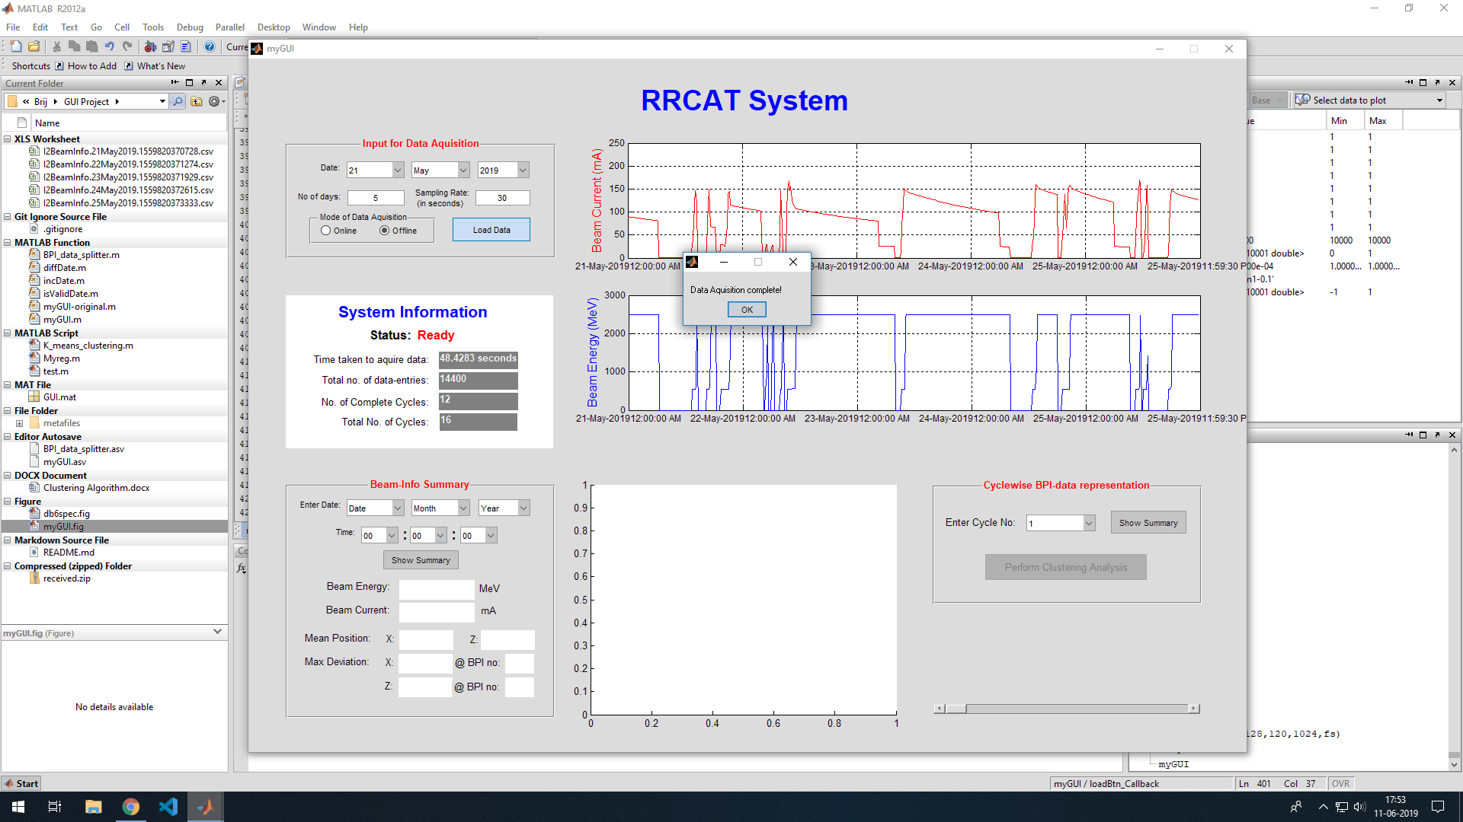

Slide 9
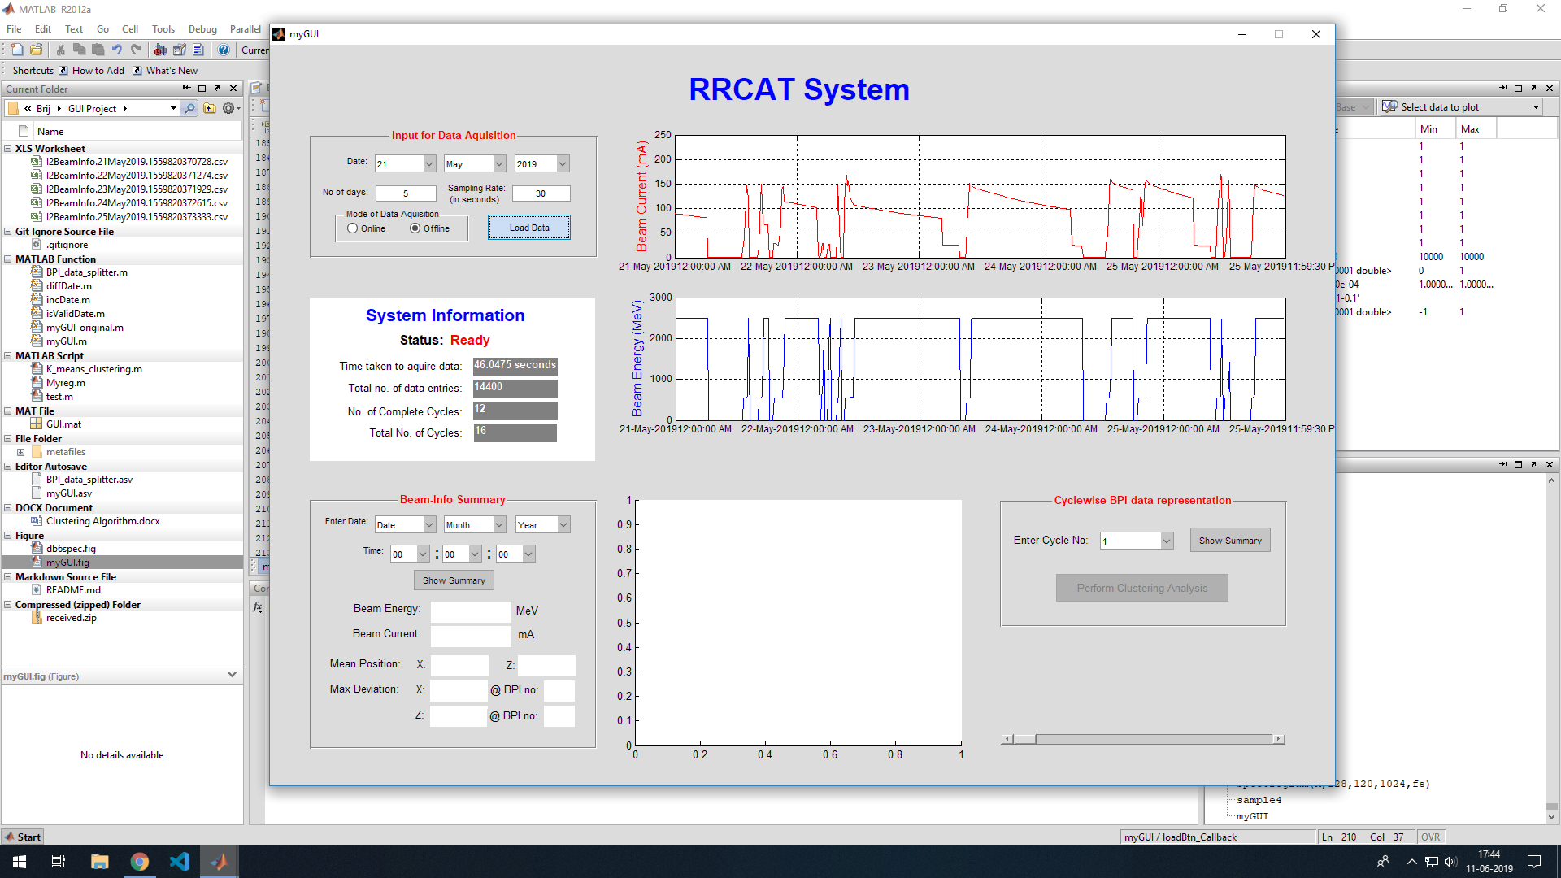

Slide 10
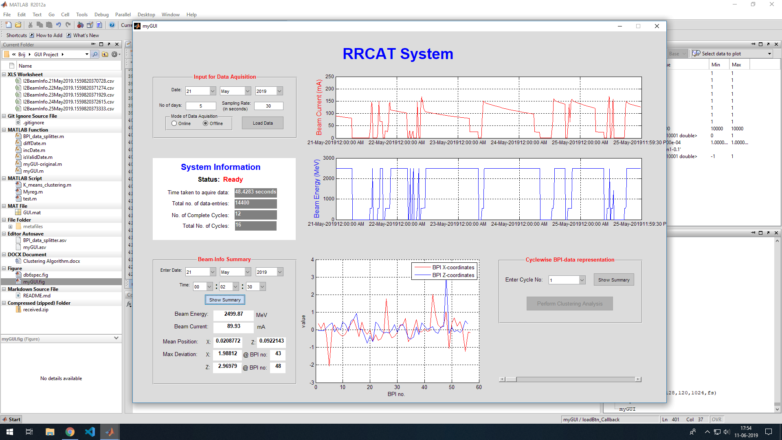

Slide 11
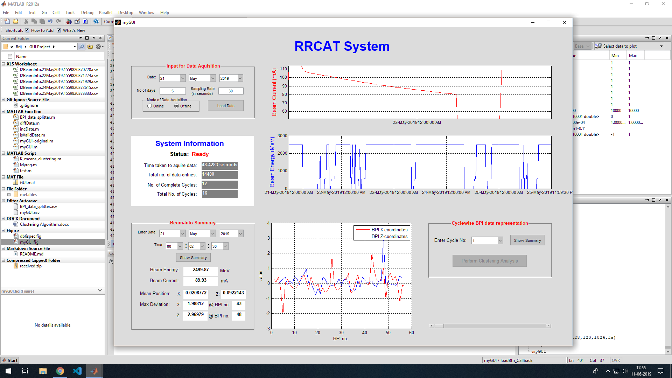

Slide 12
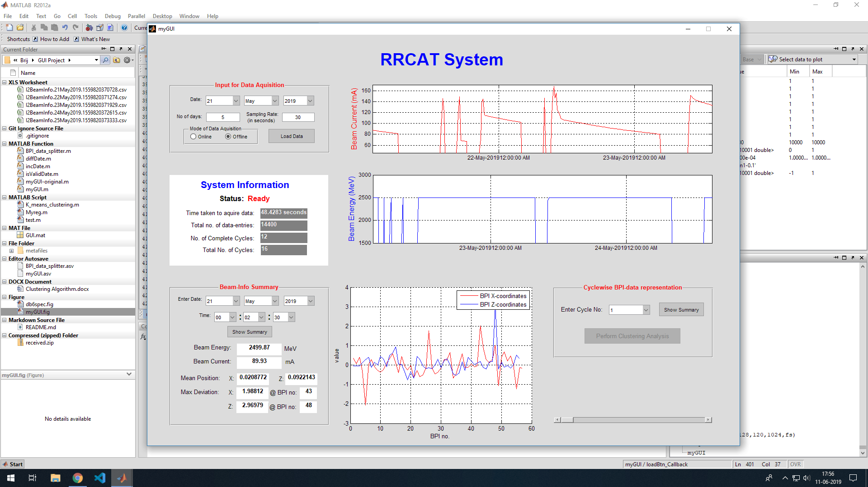

Slide 13
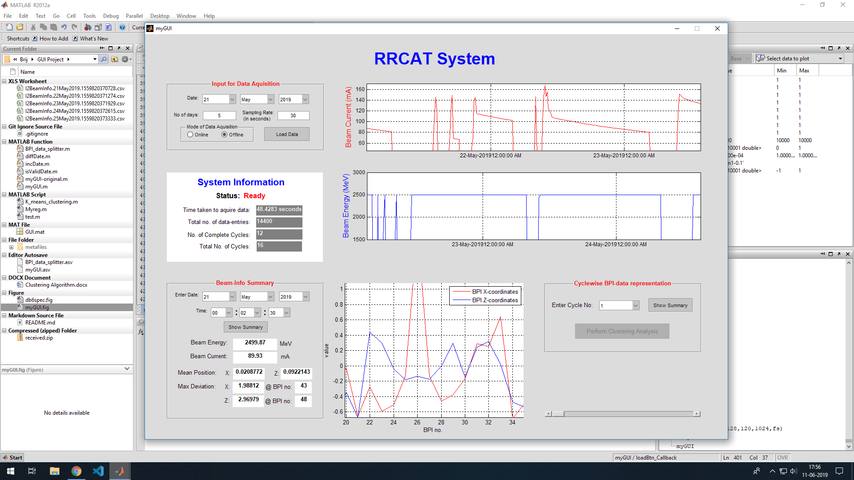

Slide 14
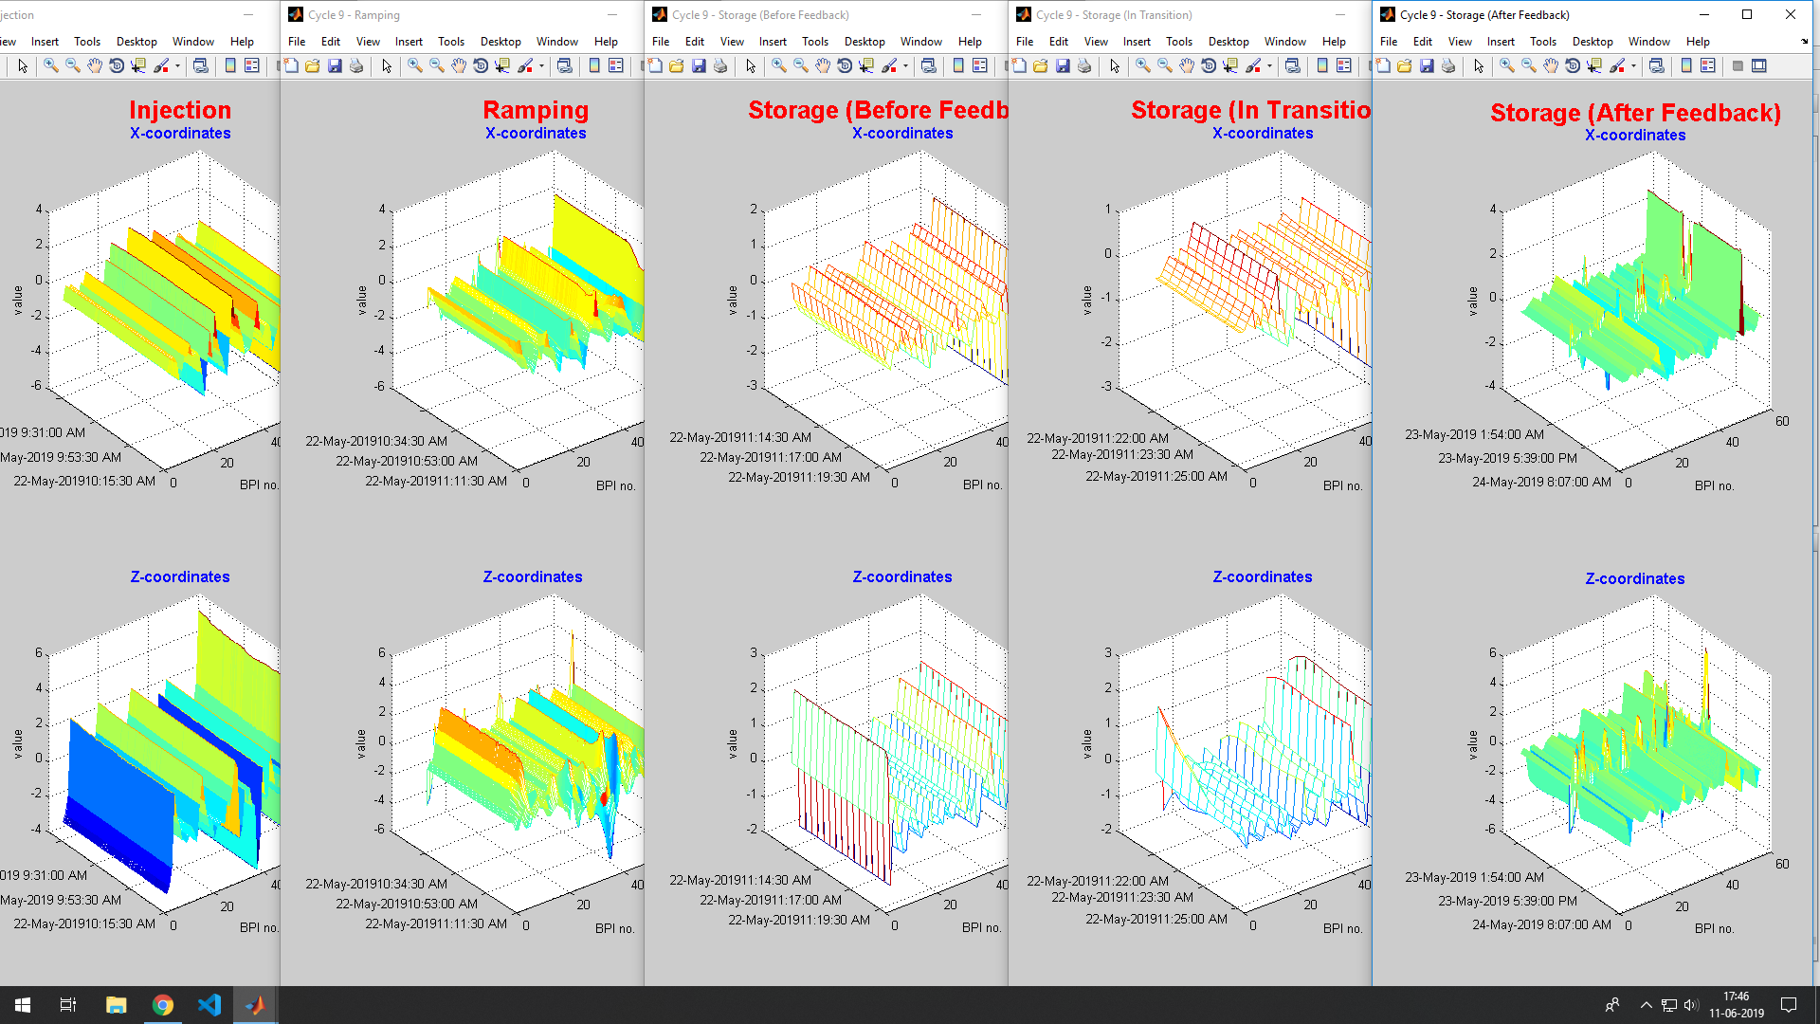

Slide 15
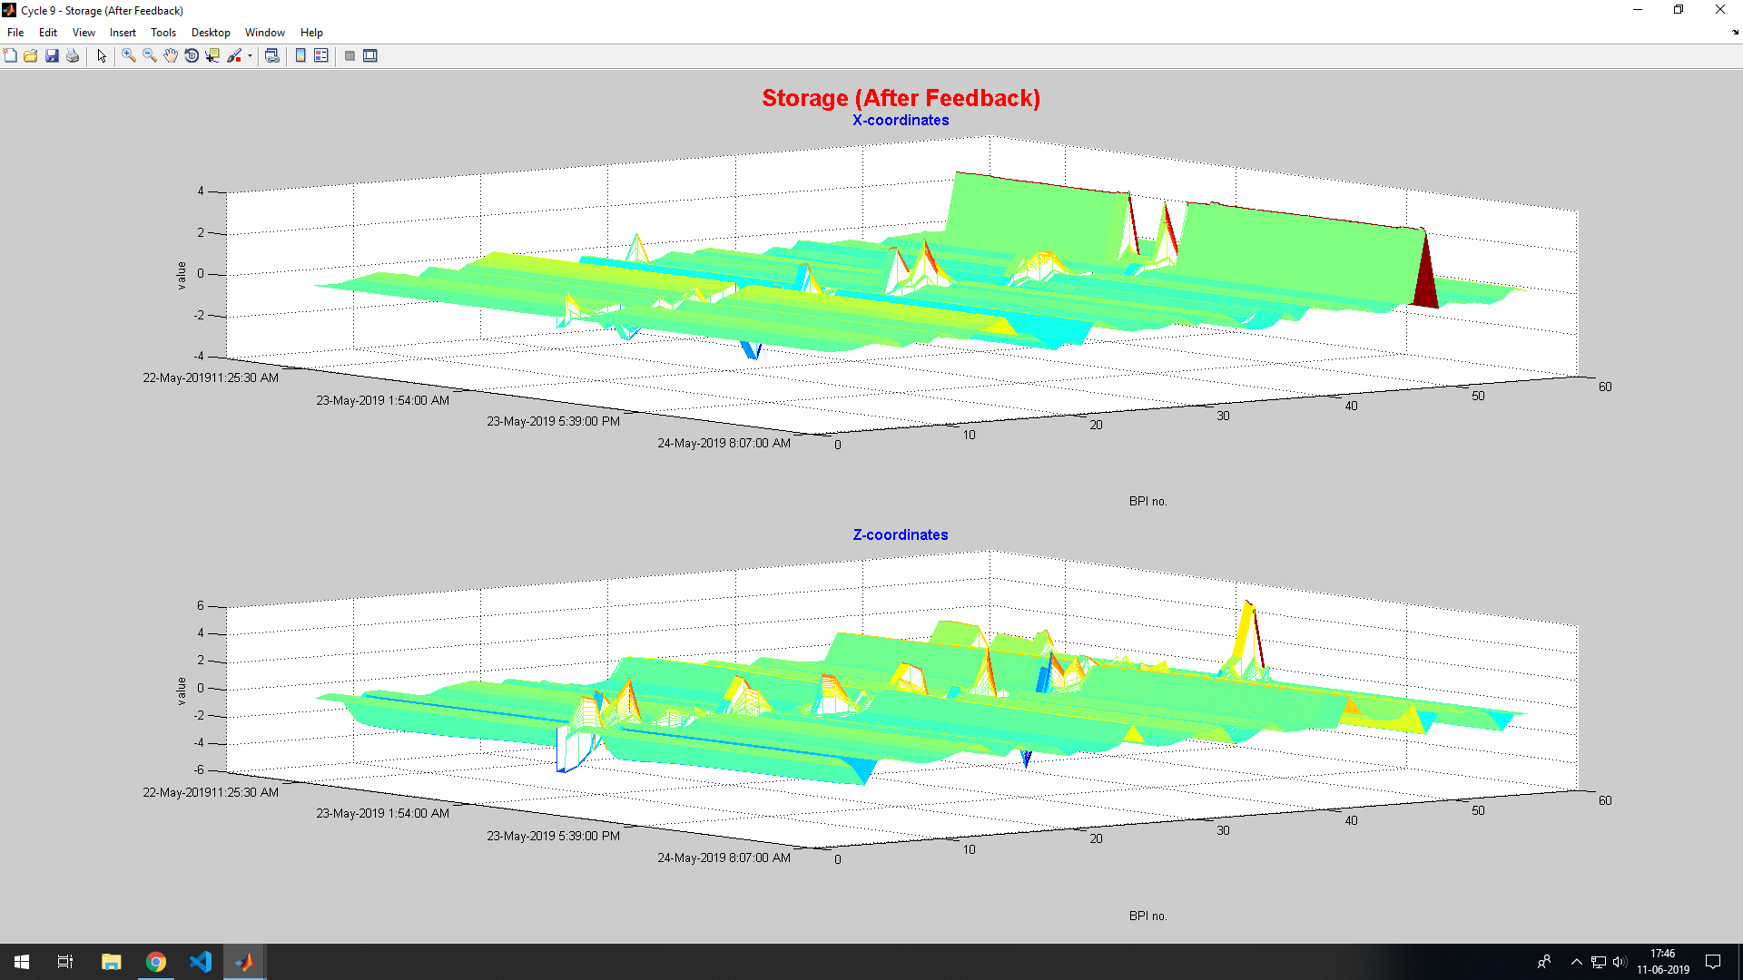

Slide 16
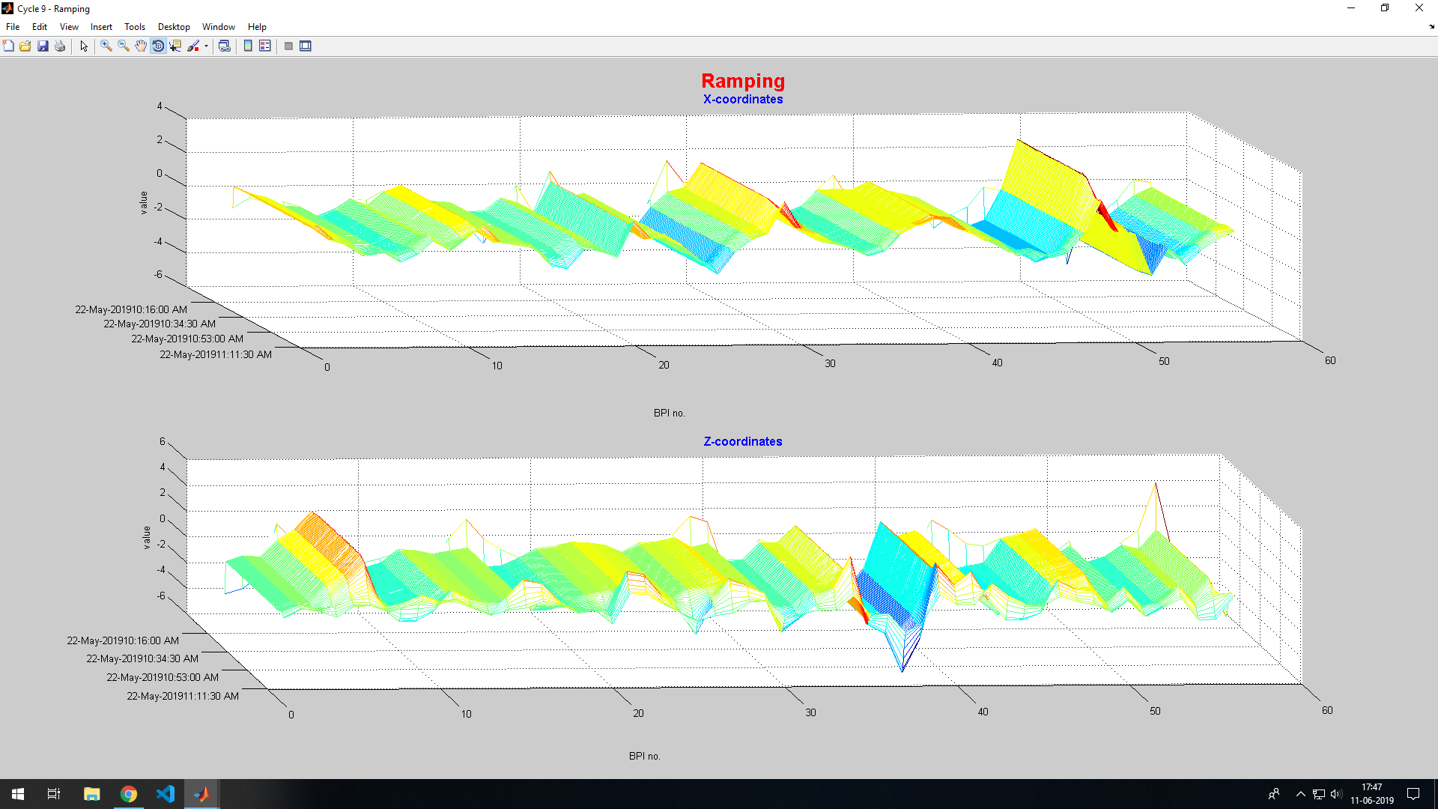

Slide 17
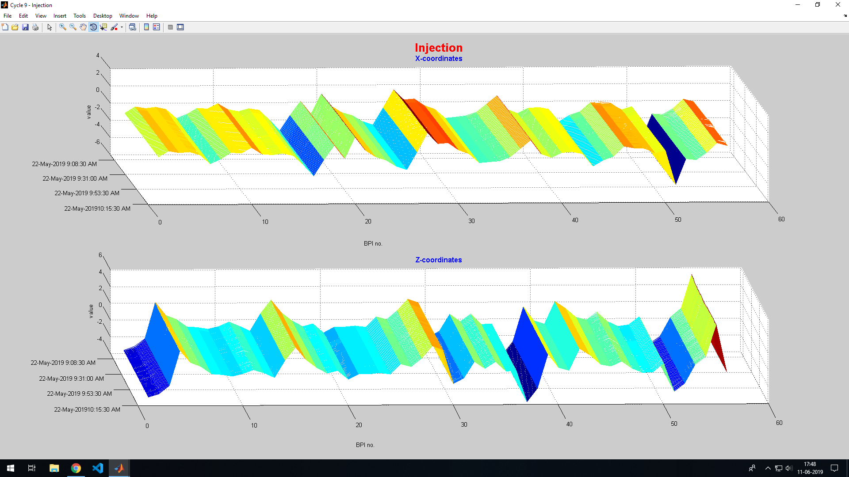

Slide 18
Error Handling:
Preventing the Unwanted….

Slide 19
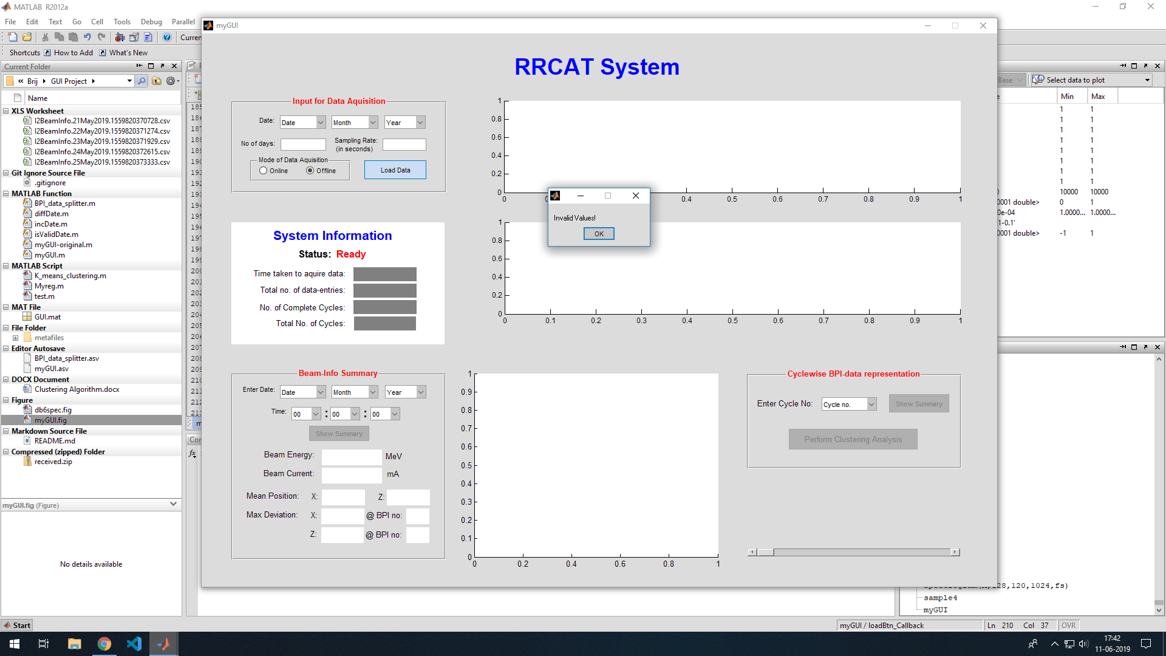

Slide 20


Slide 21
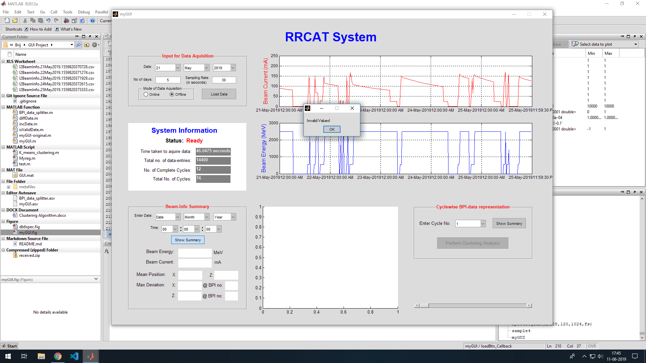

Slide 22
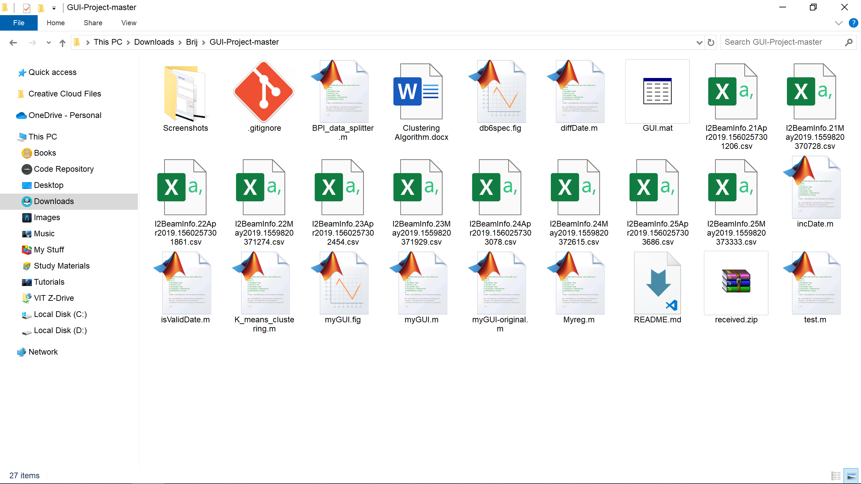


File Structure:
Cycle – 01.csv
myGUI.fig
myGUI.m
metafiles
Cycle – 02.csv
BPI_data_splitter.m
Cycle – ‘n’.csv
incDate.m
diffDate.m
validDate.m

Slide 23
Algorithms:
The behind-the-scene logic….

